Slide 1
Fundamentals of Microelectronics
CH1 Why Microelectronics?
CH2 Basic Physics of Semiconductors
CH3 Diode Circuits
CH4 Physics of Bipolar Transistors
CH5 Bipolar Amplifiers
CH6 Physics of MOS Transistors
CH7 CMOS Amplifiers
CH8 Operational Amplifier As A Black Box

Slide 2
Chapter 1 Why Microelectronics?
1.1 Electronics versus Microelectronics
1.2 Example of Electronic System: Cellular Telephone
1.3 Analog versus Digital

Slide 3
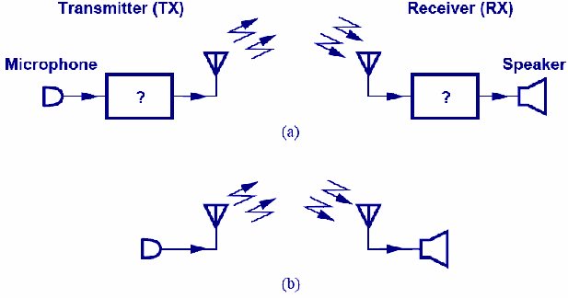
Cellular Technology
An important example of microelectronics.
Microelectronics exist in black boxes that process the received and transmitted voice signals.

Slide 4
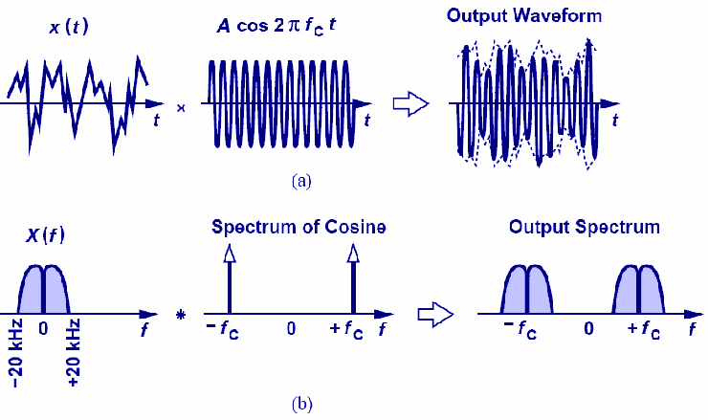
Frequency Up-conversion
Voice is “up-converted” by multiplying two sinusoids.
When multiplying two sinusoids in time domain, their spectra are convolved in frequency domain.

Slide 5
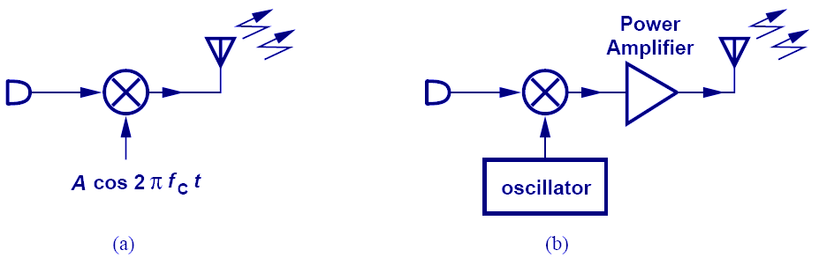
Transmitter
Two frequencies are multiplied and radiated by an antenna in (a).
A power amplifier is added in (b) to boost the signal.

Slide 6
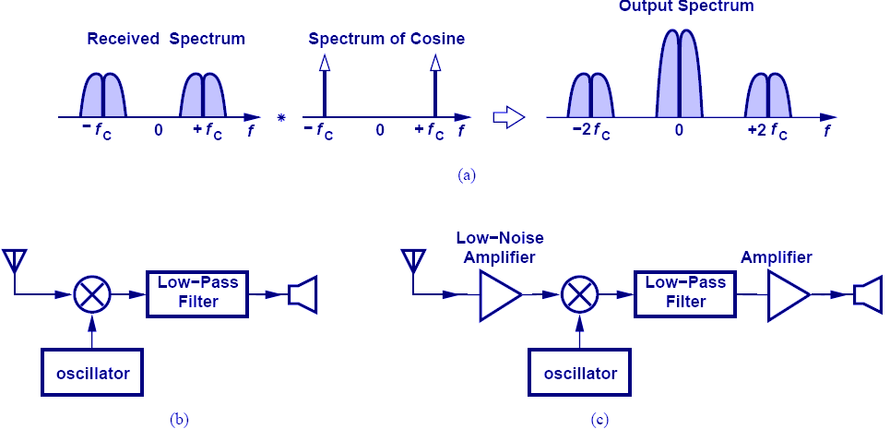
Receiver
High frequency is translated to DC by multiplying by f_{C}.
A low-noise amplifier is needed for signal boosting without excessive noise.

Slide 7
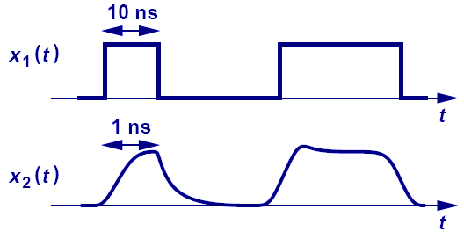
Digital or Analog?
X₁(t) is operating at 100Mb/s and X₂(t) is operating at 1Gb/s.
A digital signal operating at very high frequency is very “analog”.

Slide 8
Chapter 2 Basic Physics of Semiconductors
2.1 Semiconductor materials and their properties
2.2 PN-junction diodes
2.3 Reverse Breakdown

Slide 9
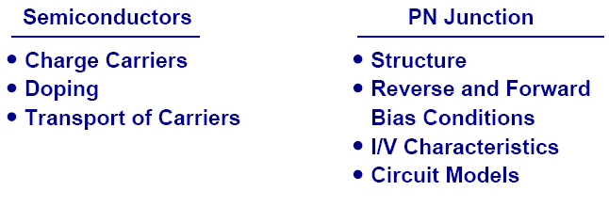
Semiconductor Physics
Semiconductor devices serve as heart of microelectronics.
PN junction is the most fundamental semiconductor device.

Slide 10
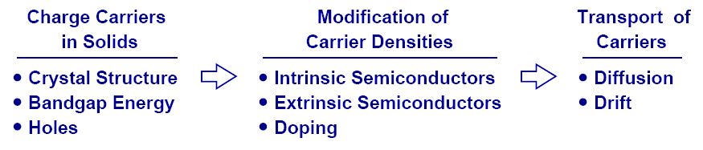
Charge Carriers in Semiconductor
To understand PN junction’s IV characteristics, it is important to understand charge carriers’ behavior in solids, how to modify carrier densities, and different mechanisms of charge flow.

Slide 11
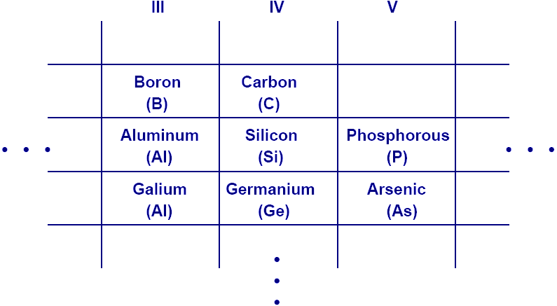
Periodic Table
This abridged table contains elements with three to five valence electrons, with Si being the most important.

Slide 12
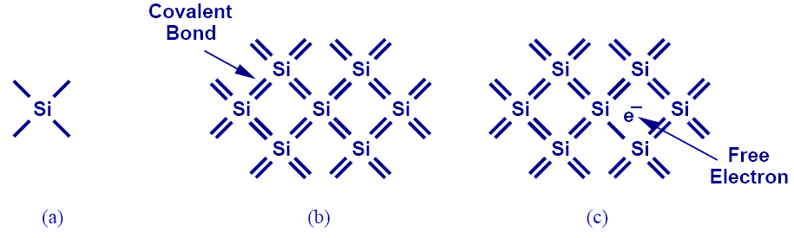
Silicon
Si has four valence electrons. Therefore, it can form covalent bonds with four of its neighbors.
When temperature goes up, electrons in the covalent bond can become free.

Slide 13
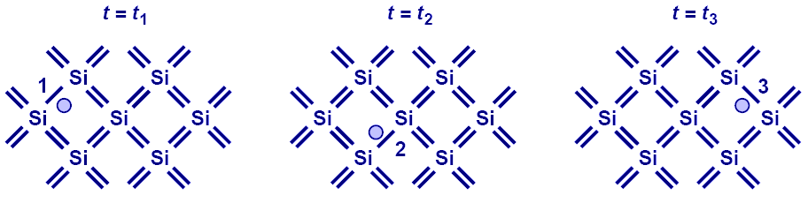
Electron-Hole Pair Interaction
With free electrons breaking off covalent bonds, holes are generated.
Holes can be filled by absorbing other free electrons, so effectively there is a flow of charge carriers.

Slide 14
Free Electron Density at a Given Temperature
E_{g}, or bandgap energy determines how much effort is needed to break off an electron from its covalent bond.
There exists an exponential relationship between the free-electron density and bandgap energy.

Slide 15
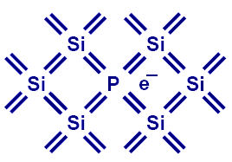
Doping (N type)
Pure Si can be doped with other elements to change its electrical properties.
For example, if Si is doped with P (phosphorous), then it has more electrons, or becomes type N (electron).

Slide 16
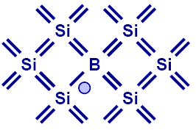
Doping (P type)
If Si is doped with B (boron), then it has more holes, or becomes type P.

Slide 17
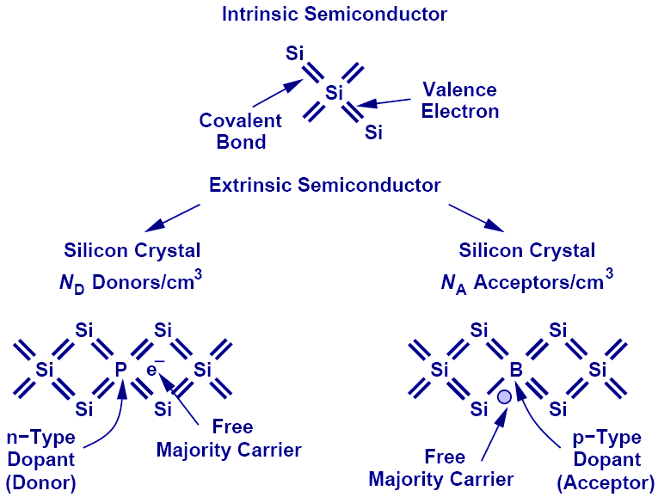
Summary of Charge Carriers

Slide 18
Electron and Hole Densities
Majority Carriers :
Minority Carriers :
Majority Carriers :
Minority Carriers :
The product of electron and hole densities is ALWAYS equal to the square of intrinsic electron density regardless of doping levels.

Slide 19
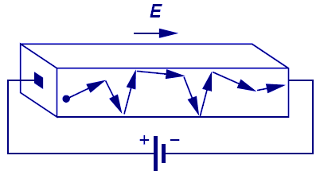
First Charge Transportation Mechanism: Drift
The process in which charge particles move because of an electric field is called drift.
Charge particles will move at a velocity that is proportional to the electric field.

Slide 20
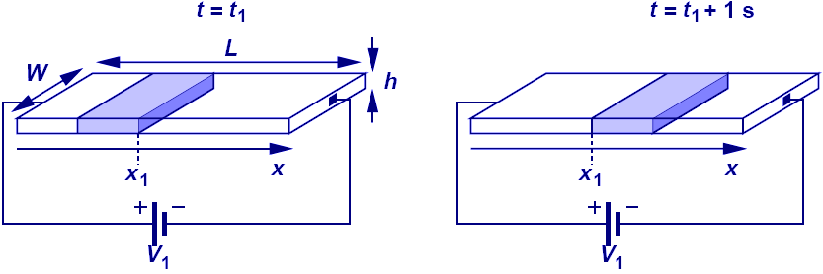
Current Flow: General Case
Electric current is calculated as the amount of charge in v meters that passes thru a cross-section if the charge travel with a velocity of v m/s.

Slide 21
Current Flow: Drift
Since velocity is equal to μE, drift characteristic is obtained by substituting V with μE in the general current equation.
The total current density consists of both electrons and holes.

Slide 22
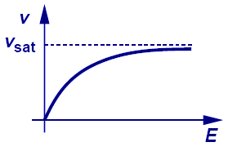
Velocity Saturation
A topic treated in more advanced courses is velocity saturation.
In reality, velocity does not increase linearly with electric field. It will eventually saturate to a critical value.

Slide 23
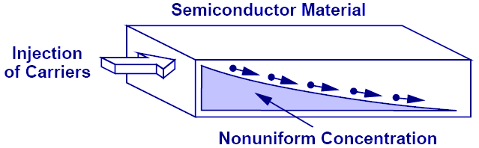
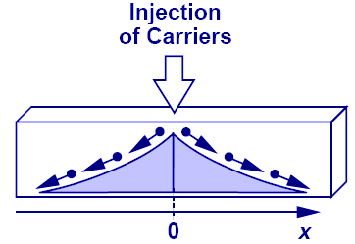
Second Charge Transportation Mechanism: Diffusion
Charge particles move from a region of high concentration to a region of low concentration. It is analogous to an every day example of an ink droplet in water.

Slide 24
Current Flow: Diffusion
Diffusion current is proportional to the gradient of charge (dn/dx) along the direction of current flow.
Its total current density consists of both electrons and holes.

Slide 25
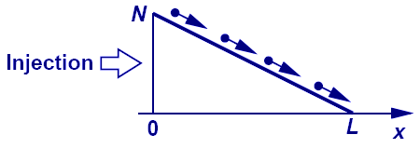
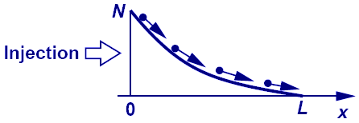
Example: Linear vs. Nonlinear Charge Density Profile
Linear charge density profile means constant diffusion current, whereas nonlinear charge density profile means varying diffusion current.

Slide 26
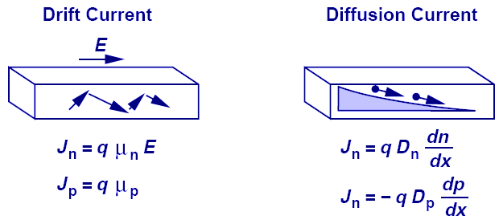
Einstein's Relation
While the underlying physics behind drift and diffusion currents are totally different, Einstein’s relation provides a mysterious link between the two.

Slide 27
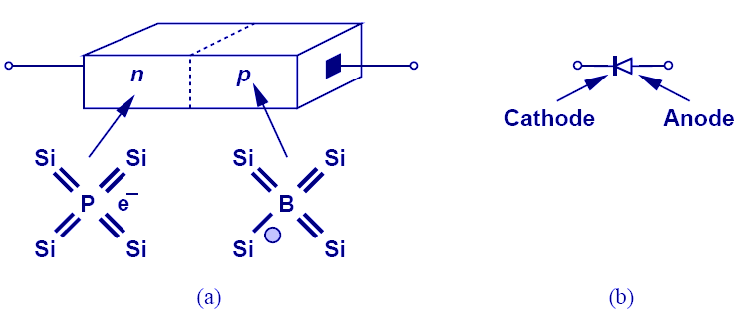
PN Junction (Diode)
When N-type and P-type dopants are introduced side-by-side in a semiconductor, a PN junction or a diode is formed.

Slide 28
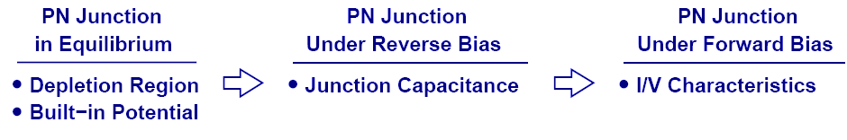
Diode’s Three Operation Regions
In order to understand the operation of a diode, it is necessary to study its three operation regions: equilibrium, reverse bias, and forward bias.

Slide 29
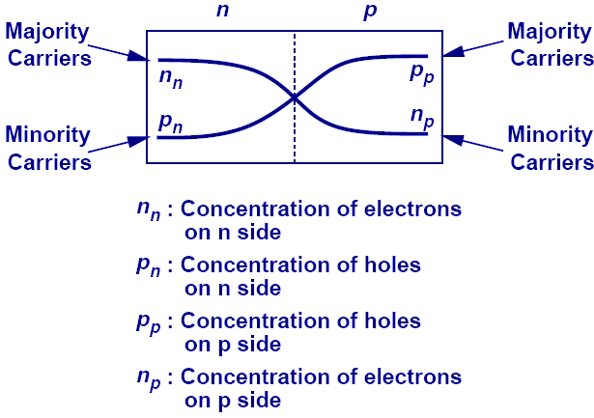
Current Flow Across Junction: Diffusion
Because each side of the junction contains an excess of holes or electrons compared to the other side, there exists a large concentration gradient. Therefore, a diffusion current flows across the junction from each side.

Slide 30
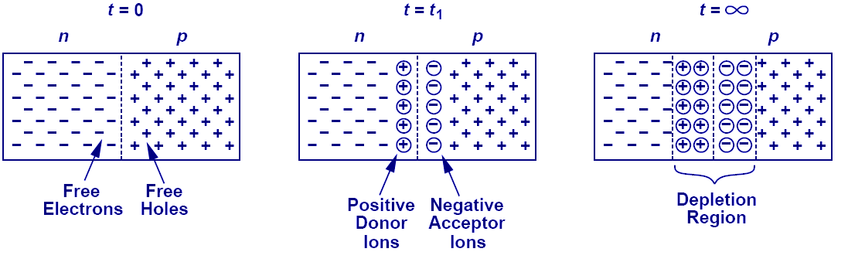
Depletion Region
As free electrons and holes diffuse across the junction, a region of fixed ions is left behind. This region is known as the “depletion region.”

Slide 31
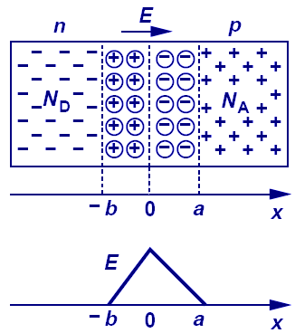
Current Flow Across Junction: Drift
The fixed ions in depletion region create an electric field that results in a drift current.

Slide 32
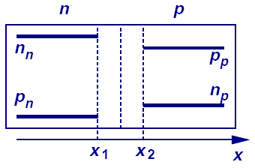
Current Flow Across Junction: Equilibrium
At equilibrium, the drift current flowing in one direction cancels out the diffusion current flowing in the opposite direction, creating a net current of zero.
The figure shows the charge profile of the PN junction.

Slide 33
Built-in Potential
Because of the electric field across the junction, there exists a built-in potential. Its derivation is shown above.

Slide 34
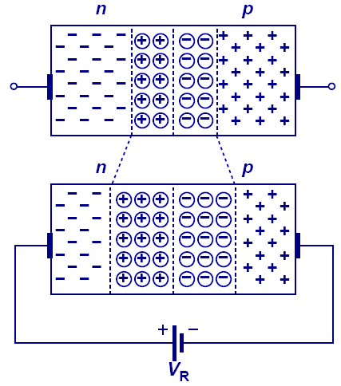
Diode in Reverse Bias
When the N-type region of a diode is connected to a higher potential than the P-type region, the diode is under reverse bias, which results in wider depletion region and larger built-in electric field across the junction.

Slide 35
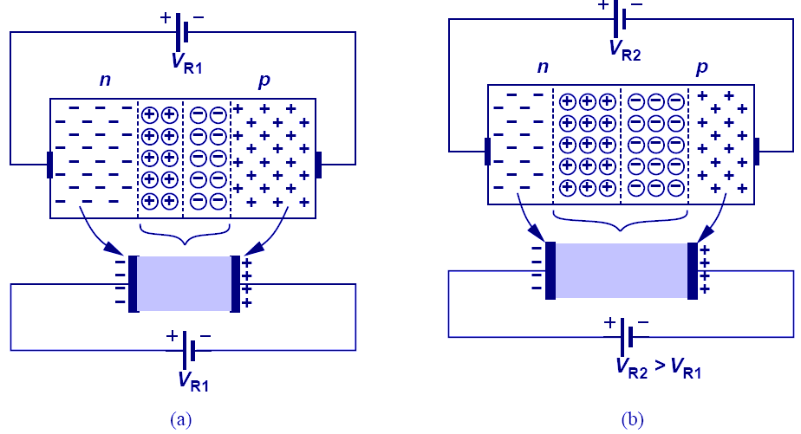
Reverse Biased Diode’s Application: Voltage-Dependent Capacitor
The PN junction can be viewed as a capacitor. By varying V_{R}, the depletion width changes, changing its capacitance value; therefore, the PN junction is actually a voltage-dependent capacitor.

Slide 36
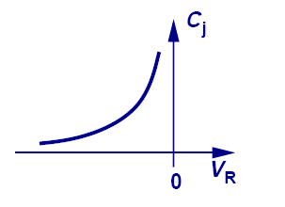
Voltage-Dependent Capacitance
The equations that describe the voltage-dependent capacitance are shown above.

Slide 37
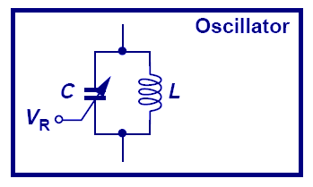
Voltage-Controlled Oscillator
A very important application of a reverse-biased PN junction is VCO, in which an LC tank is used in an oscillator. By changing V_{R}, we can change C, which also changes the oscillation frequency.

Slide 38
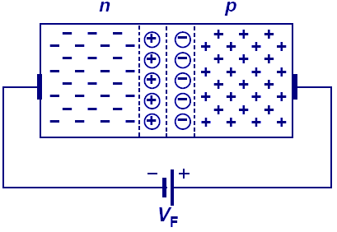
Diode in Forward Bias
When the N-type region of a diode is at a lower potential than the P-type region, the diode is in forward bias.
The depletion width is shortened and the built-in electric field decreased.

Slide 39
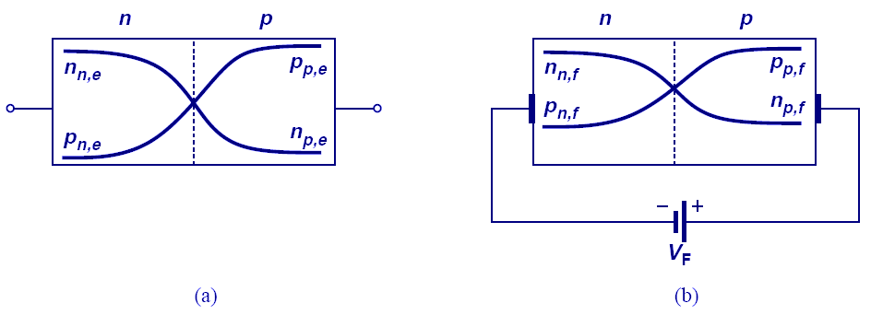
Minority Carrier Profile in Forward Bias
Under forward bias, minority carriers in each region increase due to the lowering of built-in field/potential. Therefore, diffusion currents increase to supply these minority carriers.

Slide 40
Diffusion Current in Forward Bias
Diffusion current will increase in order to supply the increase in minority carriers. The mathematics are shown above.

Slide 41
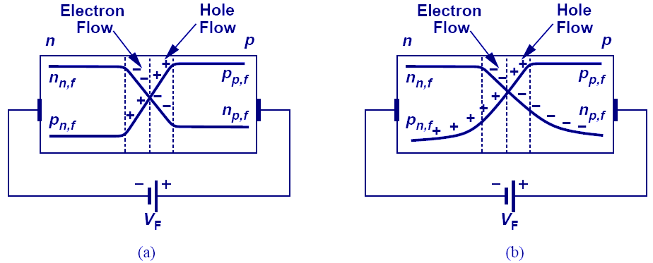
Minority Charge Gradient
Minority charge profile should not be constant along the x-axis; otherwise, there is no concentration gradient and no diffusion current.
Recombination of the minority carriers with the majority carriers accounts for the dropping of minority carriers as they go deep into the P or N region.

Slide 42
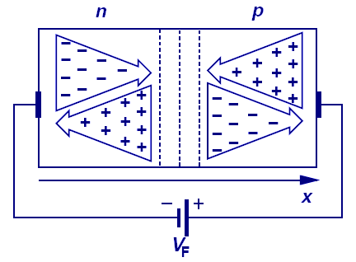
Forward Bias Condition: Summary
In forward bias, there are large diffusion currents of minority carriers through the junction. However, as we go deep into the P and N regions, recombination currents from the majority carriers dominate. These two currents add up to a constant value.

Slide 43
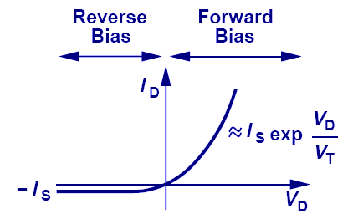
IV Characteristic of PN Junction
The current and voltage relationship of a PN junction is exponential in forward bias region, and relatively constant in reverse bias region.

Slide 44
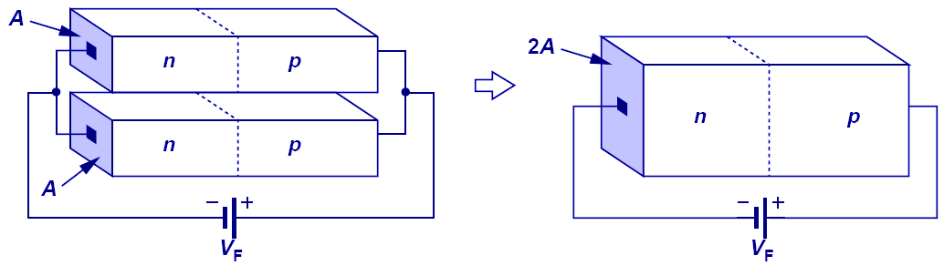
Parallel PN Junctions
Since junction currents are proportional to the junction’s cross-section area. Two PN junctions put in parallel are effectively one PN junction with twice the cross-section area, and hence twice the current.

Slide 45
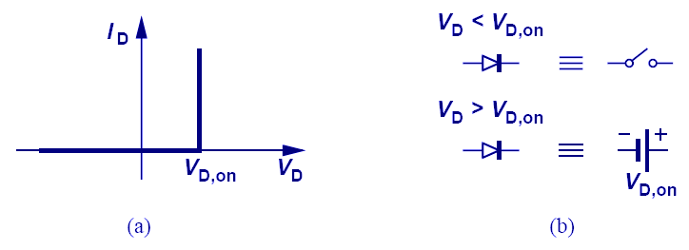
Constant-Voltage Diode Model
Diode operates as an open circuit if V_{D}< V_{D,on} and a constant voltage source of V_{D,on} if V_{D} tends to exceed V_{D,on.}

Slide 46
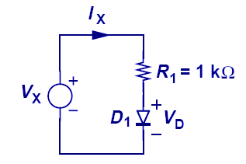
Example: Diode Calculations
for
for
This example shows the simplicity provided by a constant-voltage model over an exponential model.
For an exponential model, iterative method is needed to solve for current, whereas constant-voltage model requires only linear equations.

Slide 47
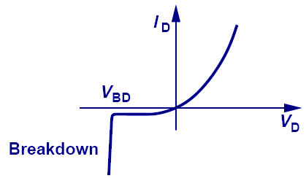
Reverse Breakdown
When a large reverse bias voltage is applied, breakdown occurs and an enormous current flows through the diode.

Slide 48
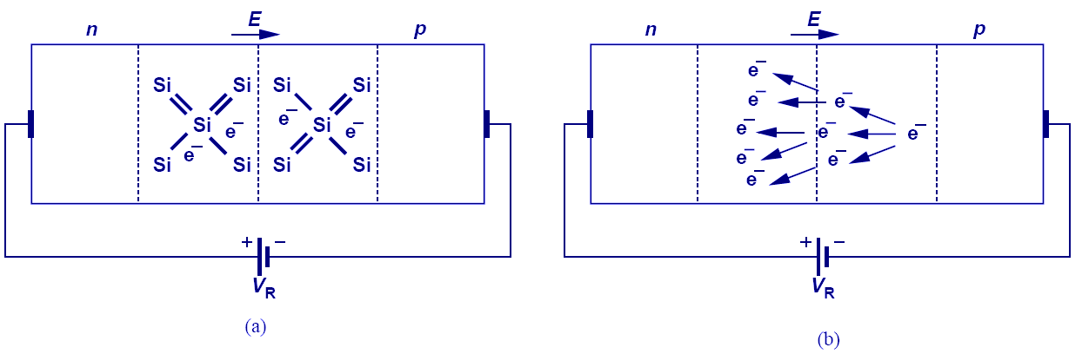
Zener vs. Avalanche Breakdown
Zener breakdown is a result of the large electric field inside the depletion region that breaks electrons or holes off their covalent bonds.
Avalanche breakdown is a result of electrons or holes colliding with the fixed ions inside the depletion region.

Slide 49
Chapter 3 Diode Circuits
3.1 Ideal Diode
3.2 PN Junction as a Diode
3.3 Applications of Diodes

Slide 50
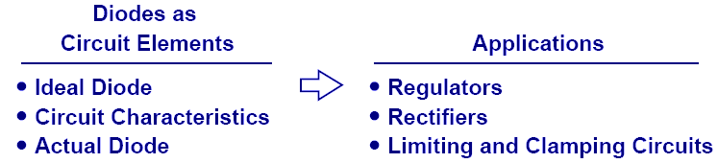
Diode Circuits
After we have studied in detail the physics of a diode, it is time to study its behavior as a circuit element and its many applications.

Slide 51
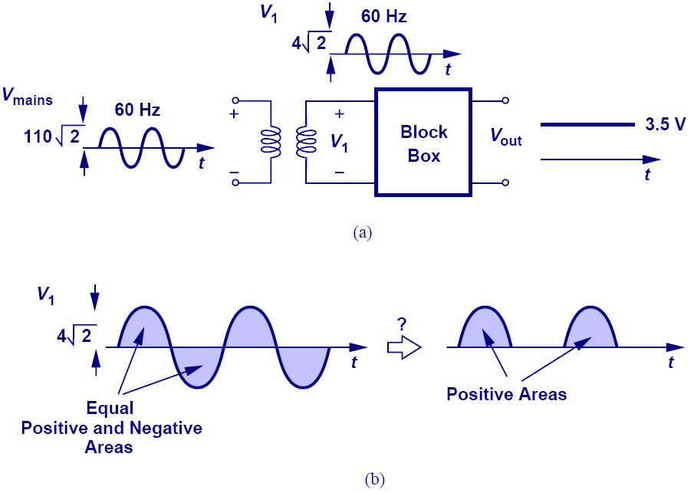
Diode’s Application: Cell Phone Charger
An important application of diode is chargers.
Diode acts as the black box (after transformer) that passes only the positive half of the stepped-down sinusoid.

Slide 52
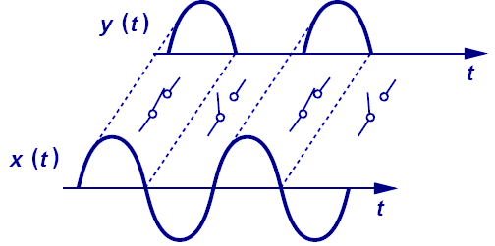
Diode’s Action in The Black Box (Ideal Diode)
The diode behaves as a short circuit during the positive half cycle (voltage across it tends to exceed zero), and an open circuit during the negative half cycle (voltage across it is less than zero).

Slide 53
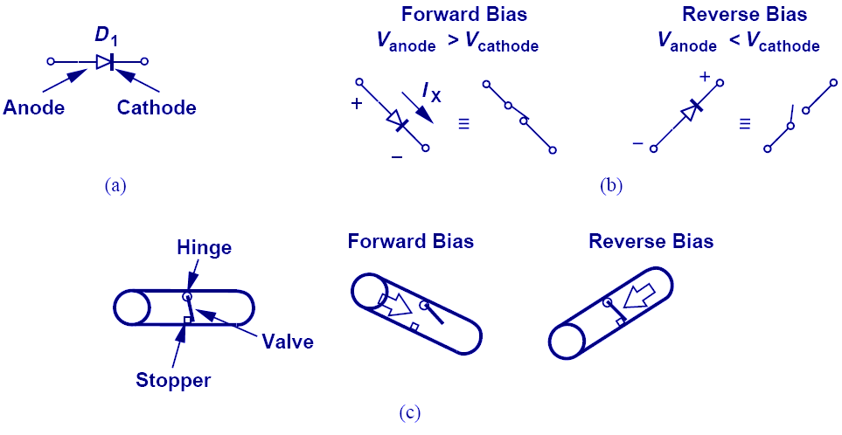
Ideal Diode
In an ideal diode, if the voltage across it tends to exceed zero, current flows.
It is analogous to a water pipe that allows water to flow in only one direction.

Slide 54
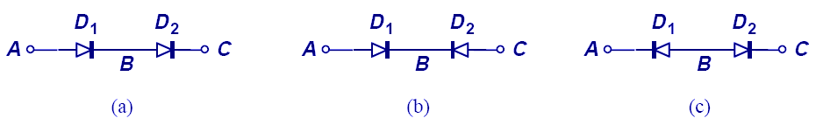
Diodes in Series
Diodes cannot be connected in series randomly. For the circuits above, only a) can conduct current from A to C.

Slide 55
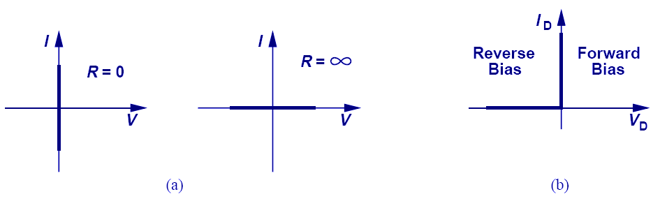
IV Characteristics of an Ideal Diode
If the voltage across anode and cathode is greater than zero, the resistance of an ideal diode is zero and current becomes infinite. However, if the voltage is less than zero, the resistance becomes infinite and current is zero.

Slide 56
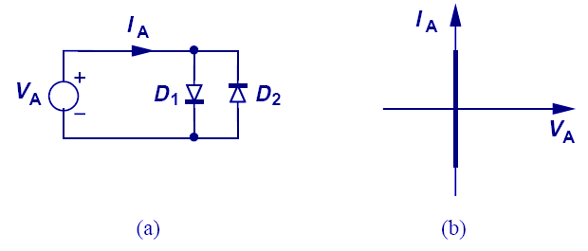
Anti-Parallel Ideal Diodes
If two diodes are connected in anti-parallel, it acts as a short for all voltages.

Slide 57
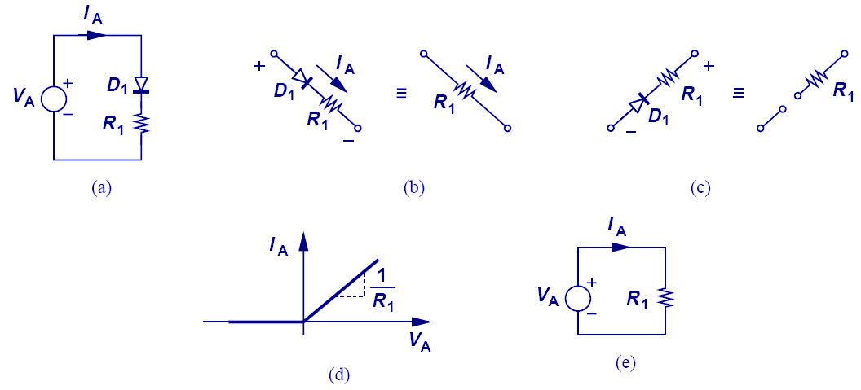
Diode-Resistor Combination
The IV characteristic of this diode-resistor combination is zero for negative voltages and Ohm’s law for positive voltages.

Slide 58
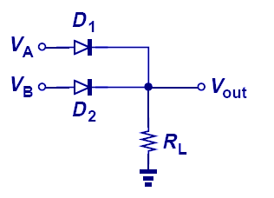
Diode Implementation of OR Gate
The circuit above shows an example of diode-implemented OR gate.
V_{out} can only be either V_{A} or V_{B}, not both.

Slide 59

Input/Output Characteristics
When V_{in} is less than zero, the diode opens, so V_{out} = V_{in}.
When V_{in} is greater than zero, the diode shorts, so V_{out} = 0.

Slide 60

Diode’s Application: Rectifier
A rectifier is a device that passes positive-half cycle of a sinusoid and blocks the negative half-cycle or vice versa.
When V_{in} is greater than 0, diode shorts, so V_{out} = V_{in}; however, when V_{in} is less than 0, diode opens, no current flows thru R₁, Vout = I_{R1}R₁ = 0.

Slide 61
Signal Strength Indicator
for
for
The averaged value of a rectifier output can be used as a signal strength indicator for the input, since V_{out,avg} is proportional to V_{p}, the input signal’s amplitude.

Slide 62

Diode’s application: Limiter
The purpose of a limiter is to force the output to remain below certain value.
In a), the addition of a 1 V battery forces the diode to turn on after V₁ has become greater than 1 V.

Slide 63

Limiter: When Battery Varies
An interesting case occurs when V_{B} (battery) varies.
Rectification fails if V_{B} is greater than the input amplitude.

Slide 64

Different Models for Diode
So far we have studied the ideal model of diode. However, there are still the exponential and constant voltage models.

Slide 65

Input/Output Characteristics with Ideal and Constant-Voltage Models
The circuit above shows the difference between the ideal and constant-voltage model; the two models yield two different break points of slope.

Slide 66

Input/Output Characteristics with a Constant-Voltage Model
When using a constant-voltage model, the voltage drop across the diode is no longer zero but V_{d,on} when it conducts.

Slide 67

Another Constant-Voltage Model Example
In this example, since Vin is connected to the cathode, the diode conducts when Vin is very negative.
The break point where the slope changes is when the current across R1 is equal to the current across R2.

Slide 68

Exponential Model
In this example, since the two diodes have different cross-section areas, only exponential model can be used.
The two currents are solved by summing them with I_{in}, and equating their voltages.

Slide 69

Another Constant-Voltage Model Example
This example shows the importance of good initial guess and careful confirmation.

Slide 70

Cell Phone Adapter
I_{x}
V_{out} = 3 V_{D,on} is used to charge cell phones.
However, if Ix changes, iterative method is often needed to obtain a solution, thus motivating a simpler technique.

Slide 71

Small-Signal Analysis
Small-signal analysis is performed around a bias point by perturbing the voltage by a small amount and observing the resulting linear current perturbation.

Slide 72

Small-Signal Analysis in Detail
If two points on the IV curve of a diode are close enough, the trajectory connecting the first to the second point is like a line, with the slope being the proportionality factor between change in voltage and change in current.

Slide 73

Small-Signal Incremental Resistance
Since there’s a linear relationship between the small signal current and voltage of a diode, the diode can be viewed as a linear resistor when only small changes are of interest.

Slide 74

Small Sinusoidal Analysis
If a sinusoidal voltage with small amplitude is applied, the resulting current is also a small sinusoid around a DC value.

Slide 75

Cause and Effect
In (a), voltage is the cause and current is the effect. In (b), the other way around.

Slide 76

Adapter Example Revisited
With our understanding of small-signal analysis, we can revisit our cell phone charger example and easily solve it with just algebra instead of iterations.

Slide 77

Simple is Beautiful
In this example we study the effect of cell phone pulling some current from the diodes. Using small signal analysis, this is easily done. However, imagine the nightmare, if we were to solve it using non-linear equations.

Slide 78
Applications of Diode

Slide 79


Half-Wave Rectifier
A very common application of diodes is half-wave rectification, where either the positive or negative half of the input is blocked.
But, how do we generate a constant output?

Slide 80

Diode-Capacitor Circuit: Constant Voltage Model
If the resistor in half-wave rectifier is replaced by a capacitor, a fixed voltage output is obtained since the capacitor (assumed ideal) has no path to discharge.

Slide 81


Diode-Capacitor Circuit: Ideal Model
Note that (b) is just like V_{in,} only shifted down.

Slide 82

Diode-Capacitor With Load Resistor
A path is available for capacitor to discharge. Therefore, V_{out} will not be constant and a ripple exists.

Slide 83


Behavior for Different Capacitor Values
For large C₁, V_{out} has small ripple.

Slide 84
Peak to Peak amplitude of Ripple
The ripple amplitude is the decaying part of the exponential.
Ripple voltage becomes a problem if it goes above 5 to 10% of the output voltage.

Slide 85

Maximum Diode Current
The diode has its maximum current at t₁, since that’s when the slope of V_{out} is the greatest.
This current has to be carefully controlled so it does not damage the device.

Slide 86

Full-Wave Rectifier
A full-wave rectifier passes both the negative and positive half cycles of the input, while inverting the negative half of the input.
As proved later, a full-wave rectifier reduces the ripple by a factor of two.

Slide 87

The Evolution of Full-Wave Rectifier
Figures (e) and (f) show the topology that inverts the negative half cycle of the input.

Slide 88

Full-Wave Rectifier: Bridge Rectifier
The figure above shows a full-wave rectifier, where D₁ and D₂ pass/invert the negative half cycle of input and D₃ and D₄ pass the positive half cycle.

Slide 89

Input/Output Characteristics of a Full-Wave Rectifier (Constant-Voltage Model)
The dead-zone around V_{in} arises because V_{in} must exceed 2 V_{D,ON} to turn on the bridge.

Slide 90

Complete Full-Wave Rectifier
Since C₁ only gets ½ of period to discharge, ripple voltage is decreased by a factor of 2. Also (b) shows that each diode is subjected to approximately one V_{p} reverse bias drop (versus 2V_{p} in half-wave rectifier).

Slide 91

Current Carried by Each Diode in the Full-Wave Rectifier

Slide 92

Summary of Half and Full-Wave Rectifiers
Full-wave rectifier is more suited to adapter and charger applications.

Slide 93

Voltage Regulator
The ripple created by the rectifier can be unacceptable to sensitive load; therefore, a regulator is required to obtain a very stable output.
Three diodes operate as a primitive regulator.

Slide 94

Voltage Regulation With Zener Diode
Voltage regulation can be accomplished with Zener diode. Since r_{d} is small, large change in the input will not be reflected at the output.

Slide 95

Line Regulation VS. Load Regulation
Line regulation is the suppression of change in V_{out} due to change in V_{in} (b).
Load regulation is the suppression of change in V_{out} due to change in load current (c).

Slide 96

Evolution of AC-DC Converter

Slide 97

Limiting Circuits
The motivation of having limiting circuits is to keep the signal below a threshold so it will not saturate the entire circuitry.
When a receiver is close to a base station, signals are large and limiting circuits may be required.

Slide 98

Input/Output Characteristics
Note the clipping of the output voltage.

Slide 99

Limiting Circuit Using a Diode: Positive Cycle Clipping
As was studied in the past, the combination of resistor-diode creates limiting effect.

Slide 100

Limiting Circuit Using a Diode: Negative Cycle Clipping

Slide 101

Limiting Circuit Using a Diode: Positive and Negative Cycle Clipping

Slide 102

General Voltage Limiting Circuit
Two batteries in series with the antiparalle diodes control the limiting voltages.

Slide 103

Non-idealities in Limiting Circuits
The clipping region is not exactly flat since as Vin increases, the currents through diodes change, and so does the voltage drop.

Slide 104

Capacitive Divider

Slide 105

Waveform Shifter: Peak at -2Vp
As V_{in} increases, D₁ turns on and V_{out} is zero.
As V_{in} decreases, D₁ turns off, and V_{out} drops with V_{in} from zero. The lowest V_{out} can go is -2V_{p}, doubling the voltage.

Slide 106

Waveform Shifter: Peak at 2Vp
Similarly, when the terminals of the diode are switched, a voltage doubler with peak value at 2V_{p} can be conceived.

Slide 107


Voltage Doubler
The output increases by V_{p,} V_{p/2,} V_{p/4,} etc in each input cycle, eventually settling to 2 V_{p.}

Slide 108

Current thru D₁ in Voltage Doubler
Notes:
After t1, D1 stops conducting…doesn’t that mean the current running thru it is zero?

Slide 109

Another Application: Voltage Shifter

Slide 110

Voltage Shifter (2V_{D,ON})

Slide 111

Diode as Electronic Switch
Diode as a switch finds application in logic circuits and data converters.

Slide 112

Junction Feedthrough
For the circuit shown in part e) of the previous slide, a small feedthrough from input to output via the junction capacitors exists even if the diodes are reverse biased
Therefore, C₁ has to be large enough to minimize this feedthrough.

Slide 113
Chapter 4 Physics of Bipolar Transistors
4.1 General Considerations
4.2 Structure of Bipolar Transistor
4.3 Operation of Bipolar Transistor in Active Mode
4.4 Bipolar Transistor Models
4.5 Operation of Bipolar Transistor in Saturation Mode
4.6 The PNP Transistor

Slide 114
Bipolar Transistor
In the chapter, we will study the physics of bipolar transistor and derive large and small signal models.

Slide 115

Voltage-Dependent Current Source
A voltage-dependent current source can act as an amplifier.
If KR_{L} is greater than 1, then the signal is amplified.

Slide 116

Voltage-Dependent Current Source with Input Resistance
Regardless of the input resistance, the magnitude of amplification remains unchanged.

Slide 117

Exponential Voltage-Dependent Current Source
A three-terminal exponential voltage-dependent current source is shown above.
Ideally, bipolar transistor can be modeled as such.

Slide 118

Structure and Symbol of Bipolar Transistor
Bipolar transistor can be thought of as a sandwich of three doped Si regions. The outer two regions are doped with the same polarity, while the middle region is doped with opposite polarity.

Slide 119

Injection of Carriers
Reverse biased PN junction creates a large electric field that sweeps any injected minority carriers to their majority region.
This ability proves essential in the proper operation of a bipolar transistor.
Notes:
The voltage here actually forward bias the PN junction, and there’s no 4.6a), just 4.6.

Slide 120

Forward Active Region
Forward active region: V_{BE} > 0, V_{BC} < 0.
Figure b) presents a wrong way of modeling figure a).

Slide 121


Accurate Bipolar Representation
Collector also carries current due to carrier injection from base.

Slide 122

Carrier Transport in Base

Slide 123
Collector Current
Applying the law of diffusion, we can determine the charge flow across the base region into the collector.
The equation above shows that the transistor is indeed a voltage-controlled element, thus a good candidate as an amplifier.

Slide 124

Parallel Combination of Transistors
When two transistors are put in parallel and experience the same potential across all three terminals, they can be thought of as a single transistor with twice the emitter area.

Slide 125

Simple Transistor Configuration
Although a transistor is a voltage to current converter, output voltage can be obtained by inserting a load resistor at the output and allowing the controlled current to pass thru it.

Slide 126

Constant Current Source
Ideally, the collector current does not depend on the collector to emitter voltage. This property allows the transistor to behave as a constant current source when its base-emitter voltage is fixed.

Slide 127

Base Current
Base current consists of two components: 1) Reverse injection of holes into the emitter and 2) recombination of holes with electrons coming from the emitter.

Slide 128
Emitter Current
Applying Kirchoff’s current law to the transistor, we can easily find the emitter current.

Slide 129
Summary of Currents

Slide 130

Bipolar Transistor Large Signal Model
A diode is placed between base and emitter and a voltage controlled current source is placed between the collector and emitter.

Slide 131

Example: Maximum R_{L}
As R_{L} increases, V_{x} drops and eventually forward biases the collector-base junction. This will force the transistor out of forward active region.
Therefore, there exists a maximum tolerable collector resistance.

Slide 132

Characteristics of Bipolar Transistor

Slide 133

Example: IV Characteristics

Slide 134

Transconductance
Transconductance, g_{m} shows a measure of how well the transistor converts voltage to current.
It will later be shown that g_{m} is one of the most important parameters in circuit design.

Slide 135

Visualization of Transconductance
g_{m} can be visualized as the slope of I_{C} versus V_{BE.}
A large I_{C} has a large slope and therefore a large g_{m.}

Slide 136

Transconductance and Area
When the area of a transistor is increased by n, I_{S} increases by n. For a constant V_{BE,} I_{C} and hence g_{m} increases by a factor of n.

Slide 137

Transconductance and I_{c}
The figure above shows that for a given V_{BE} swing, the current excursion around I_{C2} is larger than it would be around I_{C1}. This is because g_{m} is larger I_{C2}.

Slide 138

Small-Signal Model: Derivation
Small signal model is derived by perturbing voltage difference every two terminals while fixing the third terminal and analyzing the change in current of all three terminals. We then represent these changes with controlled sources or resistors.

Slide 139

Small-Signal Model: V_{BE} Change

Slide 140

Small-Signal Model: V_{CE} Change
Ideally, V_{CE} has no effect on the collector current. Thus, it will not contribute to the small signal model.
It can be shown that V_{CB} has no effect on the small signal model, either.

Slide 141

Small Signal Example I
Here, small signal parameters are calculated from DC operating point and are used to calculate the change in collector current due to a change in V_{BE}.

Slide 142


Small Signal Example II
In this example, a resistor is placed between the power supply and collector, therefore, providing an output voltage.

Slide 143
AC Ground
Since the power supply voltage does not vary with time, it is regarded as a ground in small-signal analysis.

Slide 144

Early Effect
The claim that collector current does not depend on V_{CE} is not accurate.
As V_{CE} increases, the depletion region between base and collector increases. Therefore, the effective base width decreases, which leads to an increase in the collector current.

Slide 145

Early Effect Illustration
With Early effect, collector current becomes larger than usual and a function of V_{CE.}

Slide 146

Early Effect Representation

Slide 147

Early Effect and Large-Signal Model
Early effect can be accounted for in large-signal model by simply changing the collector current with a correction factor.
In this mode, base current does not change.

Slide 148

Early Effect and Small-Signal Model

Slide 149

Summary of Ideas

Slide 150

Bipolar Transistor in Saturation
When collector voltage drops below base voltage and forward biases the collector-base junction, base current increases and decreases the current gain factor, β.

Slide 151

Large-Signal Model for Saturation Region

Slide 152

Overall I/V Characteristics
The speed of the BJT also drops in saturation.

Slide 153

Example: Acceptable V_{CC} Region
In order to keep BJT at least in soft saturation region, the collector voltage must not fall below the base voltage by more than 400mV.
A linear relationship can be derived for V_{CC} and R_{C} and an acceptable region can be chosen.

Slide 154

Deep Saturation
In deep saturation region, the transistor loses its voltage-controlled current capability and V_{CE} becomes constant.

Slide 155

PNP Transistor
With the polarities of emitter, collector, and base reversed, a PNP transistor is formed.
All the principles that applied to NPN's also apply to PNP’s, with the exception that emitter is at a higher potential than base and base at a higher potential than collector.

Slide 156

A Comparison between NPN and PNP Transistors
The figure above summarizes the direction of current flow and operation regions for both the NPN and PNP BJT’s.

Slide 157
PNP Equations
Early Effect

Slide 158

Large Signal Model for PNP

Slide 159

PNP Biasing
Note that the emitter is at a higher potential than both the base and collector.

Slide 160

Small Signal Analysis

Slide 161

Small-Signal Model for PNP Transistor
The small signal model for PNP transistor is exactly IDENTICAL to that of NPN. This is not a mistake because the current direction is taken care of by the polarity of V_{BE.}

Slide 162


Small Signal Model Example I

Slide 163


Small Signal Model Example II
Small-signal model is identical to the previous ones.

Slide 164


Small Signal Model Example III
Since during small-signal analysis, a constant voltage supply is considered to be AC ground, the final small-signal model is identical to the previous two.

Slide 165


Small Signal Model Example IV

Slide 166
Chapter 5 Bipolar Amplifiers
5.1 General Considerations
5.2 Operating Point Analysis and Design
5.3 Bipolar Amplifier Topologies
5.4 Summary and Additional Examples

Slide 167

Bipolar Amplifiers

Slide 168

Voltage Amplifier
In an ideal voltage amplifier, the input impedance is infinite and the output impedance zero.
But in reality, input or output impedances depart from their ideal values.

Slide 169

Input/Output Impedances
The figure above shows the techniques of measuring input and output impedances.

Slide 170

Input Impedance Example I
When calculating input/output impedance, small-signal analysis is assumed.

Slide 171

Impedance at a Node
When calculating I/O impedances at a port, we usually ground one terminal while applying the test source to the other terminal of interest.

Slide 172

Impedance at Collector
With Early effect, the impedance seen at the collector is equal to the intrinsic output impedance of the transistor (if emitter is grounded).

Slide 173

Impedance at Emitter
The impedance seen at the emitter of a transistor is approximately equal to one over its transconductance (if the base is grounded).

Slide 174

Three Master Rules of Transistor Impedances
Rule # 1: looking into the base, the impedance is r_{π} if emitter is (ac) grounded.
Rule # 2: looking into the collector, the impedance is r_{o} if emitter is (ac) grounded.
Rule # 3: looking into the emitter, the impedance is 1/g_{m} if base is (ac) grounded and Early effect is neglected.

Slide 175

Biasing of BJT
Transistors and circuits must be biased because (1) transistors must operate in the active region, (2) their small-signal parameters depend on the bias conditions.

Slide 176

DC Analysis vs. Small-Signal Analysis
First, DC analysis is performed to determine operating point and obtain small-signal parameters.
Second, sources are set to zero and small-signal model is used.

Slide 177

Notation Simplification
Hereafter, the battery that supplies power to the circuit is replaced by a horizontal bar labeled Vcc, and input signal is simplified as one node called V_{in.}

Slide 178

Example of Bad Biasing
The microphone is connected to the amplifier in an attempt to amplify the small output signal of the microphone.
Unfortunately, there’s no DC bias current running thru the transistor to set the transconductance.

Slide 179

Another Example of Bad Biasing
The base of the amplifier is connected to V_{cc}, trying to establish a DC bias.
Unfortunately, the output signal produced by the microphone is shorted to the power supply.

Slide 180

Biasing with Base Resistor
Assuming a constant value for V_{BE}, one can solve for both I_{B} and I_{C} and determine the terminal voltages of the transistor.
However, bias point is sensitive to β variations.

Slide 181

Improved Biasing: Resistive Divider
Using resistor divider to set V_{BE}, it is possible to produce an I_{C} that is relatively independent of β if base current is small.

Slide 182

Accounting for Base Current
With proper ratio of R₁ and R₂, I_{C} can be insensitive to β; however, its exponential dependence on resistor deviations makes it less useful.

Slide 183

Emitter Degeneration Biasing
The presence of R_{E} helps to absorb the error in V_{X} so V_{BE} stays relatively constant.
This bias technique is less sensitive to β (I₁ >> I_{B}) and V_{BE} variations.

Slide 184
Design Procedure
Choose an I_{C} to provide the necessary small signal parameters, g_{m}, r_{π}, etc.
Considering the variations of R₁, R₂, and V_{BE}, choose a value for V_{RE.}
With V_{RE} chosen, and V_{BE} calculated, V_{x} can be determined.
Select R₁ and R₂ to provide V_{x.}

Slide 185

Self-Biasing Technique
This bias technique utilizes the collector voltage to provide the necessary V_{x} and I_{B}.
One important characteristic of this technique is that collector has a higher potential than the base, thus guaranteeing active operation of the transistor.

Slide 186
Self-Biasing Design Guidelines
(1) provides insensitivity to β .
(2) provides insensitivity to variation in V_{BE .}

Slide 187

Summary of Biasing Techniques

Slide 188




PNP Biasing Techniques
Same principles that apply to NPN biasing also apply to PNP biasing with only polarity modifications.

Slide 189

Possible Bipolar Amplifier Topologies
Three possible ways to apply an input to an amplifier and three possible ways to sense its output.
However, in reality only three of six input/output combinations are useful.

Slide 190
Study of Common-Emitter Topology
Analysis of CE Core
Inclusion of Early Effect
Emitter Degeneration
Inclusion of Early Effect
CE Stage with Biasing

Slide 191

Common-Emitter Topology

Slide 192

Small Signal of CE Amplifier

Slide 193

Limitation on CE Voltage Gain
Since g_{m} can be written as I_{C}/V_{T}, the CE voltage gain can be written as the ratio of V_{RC} and V_{T.}
V_{RC} is the potential difference between V_{CC} and V_{CE}, and V_{CE} cannot go below V_{BE} in order for the transistor to be in active region.

Slide 194

Tradeoff between Voltage Gain and Headroom

Slide 195

I/O Impedances of CE Stage
When measuring output impedance, the input port has to be grounded so that V_{in} = 0.

Slide 196

CE Stage Trade-offs

Slide 197

Inclusion of Early Effect
Early effect will lower the gain of the CE amplifier, as it appears in parallel with R_{C}.

Slide 198
Intrinsic Gain
As R_{C} goes to infinity, the voltage gain reaches the product of g_{m} and r_{O}, which represents the maximum voltage gain the amplifier can have.
The intrinsic gain is independent of the bias current.

Slide 199
Current Gain
Another parameter of the amplifier is the current gain, which is defined as the ratio of current delivered to the load to the current flowing into the input.
For a CE stage, it is equal to β.

Slide 200

Emitter Degeneration
By inserting a resistor in series with the emitter, we “degenerate” the CE stage.
This topology will decrease the gain of the amplifier but improve other aspects, such as linearity, and input impedance.

Slide 201

Small-Signal Model
Interestingly, this gain is equal to the total load resistance to ground divided by 1/g_{m} plus the total resistance placed in series with the emitter.

Slide 202

Emitter Degeneration Example I
The input impedance of Q₂ can be combined in parallel with R_{E} to yield an equivalent impedance that degenerates Q₁.

Slide 203

Emitter Degeneration Example II
In this example, the input impedance of Q₂ can be combined in parallel with R_{C} to yield an equivalent collector impedance to ground.

Slide 204

Input Impedance of Degenerated CE Stage
With emitter degeneration, the input impedance is increased from r_{π} to r_{π} + (β+1)R_{E}; a desirable effect.

Slide 205

Output Impedance of Degenerated CE Stage
Emitter degeneration does not alter the output impedance in this case. (More on this later.)

Slide 206

Capacitor at Emitter
At DC the capacitor is open and the current source biases the amplifier.
For ac signals, the capacitor is short and the amplifier is degenerated by R_{E}.

Slide 207

Example: Design CE Stage with Degeneration as a Black Box
If g_{m}R_{E} is much greater than unity, G_{m} is more linear.

Slide 208

Degenerated CE Stage with Base Resistance

Slide 209

Input/Output Impedances
R_{in1} is more important in practice as R_{B} is often the output impedance of the previous stage.

Slide 210

Emitter Degeneration Example III

Slide 211

Output Impedance of Degenerated Stage with V_{A}<
Emitter degeneration boosts the output impedance by a factor of 1+g_{m}(R_{E}||r_{π}).
This improves the gain of the amplifier and makes the circuit a better current source.

Slide 212

Two Special Cases

Slide 213

Analysis by Inspection
This seemingly complicated circuit can be greatly simplified by first recognizing that the capacitor creates an AC short to ground, and gradually transforming the circuit to a known topology.

Slide 214

Example: Degeneration by Another Transistor
Called a “cascode”, the circuit offers many advantages that are described later in the book.

Slide 215
Study of Common-Emitter Topology
Analysis of CE Core
Inclusion of Early Effect
Emitter Degeneration
Inclusion of Early Effect
CE Stage with Biasing

Slide 216

Bad Input Connection
Since the microphone has a very low resistance that connects from the base of Q₁ to ground, it attenuates the base voltage and renders Q₁ without a bias current.

Slide 217

Use of Coupling Capacitor
Capacitor isolates the bias network from the microphone at DC but shorts the microphone to the amplifier at higher frequencies.

Slide 218

DC and AC Analysis
Coupling capacitor is open for DC calculations and shorted for AC calculations.

Slide 219

Bad Output Connection
Since the speaker has an inductor, connecting it directly to the amplifier would short the collector at DC and therefore push the transistor into deep saturation.

Slide 220

Still No Gain!!!
In this example, the AC coupling indeed allows correct biasing. However, due to the speaker’s small input impedance, the overall gain drops considerably.

Slide 221

CE Stage with Biasing

Slide 222

CE Stage with Robust Biasing

Slide 223

Removal of Degeneration for Signals at AC
Capacitor shorts out R_{E} at higher frequencies and removes degeneration.

Slide 224

Complete CE Stage

Slide 225

Summary of CE Concepts

Slide 226

Common Base (CB) Amplifier
In common base topology, where the base terminal is biased with a fixed voltage, emitter is fed with a signal, and collector is the output.

Slide 227

CB Core
The voltage gain of CB stage is g_{m}R_{C}, which is identical to that of CE stage in magnitude and opposite in phase.

Slide 228

Tradeoff between Gain and Headroom
To maintain the transistor out of saturation, the maximum voltage drop across R_{C} cannot exceed V_{CC}-V_{BE.}

Slide 229

Simple CB Example

Slide 230

Input Impedance of CB
The input impedance of CB stage is much smaller than that of the CE stage.

Slide 231

Practical Application of CB Stage
To avoid “reflections”, need impedance matching.
CB stage’s low input impedance can be used to create a match with 50 Ω.

Slide 232

Output Impedance of CB Stage
The output impedance of CB stage is similar to that of CE stage.

Slide 233

CB Stage with Source Resistance
With an inclusion of a source resistor, the input signal is attenuated before it reaches the emitter of the amplifier; therefore, we see a lower voltage gain.
This is similar to CE stage emitter degeneration; only the phase is reversed.

Slide 234

Practical Example of CB Stage
An antenna usually has low output impedance; therefore, a correspondingly low input impedance is required for the following stage.

Slide 235

Realistic Output Impedance of CB Stage
The output impedance of CB stage is equal to R_{C} in parallel with the impedance looking down into the collector.

Slide 236

Output Impedance of CE and CB Stages
The output impedances of CE, CB stages are the same if both circuits are under the same condition. This is because when calculating output impedance, the input port is grounded, which renders the same circuit for both CE and CB stages.

Slide 237

Fallacy of the “Old Wisdom”
The statement “CB output impedance is higher than CE output impedance” is flawed.

Slide 238

CB with Base Resistance
With an addition of base resistance, the voltage gain degrades.

Slide 239

Comparison of CE and CB Stages with Base Resistance
The voltage gain of CB amplifier with base resistance is exactly the same as that of CE stage with base resistance and emitter degeneration, except for a negative sign.

Slide 240

Input Impedance of CB Stage with Base Resistance
The input impedance of CB with base resistance is equal to 1/g_{m} plus R_{B} divided by (β+1). This is in contrast to degenerated CE stage, in which the resistance in series with the emitter is multiplied by (β+1) when seen from the base.

Slide 241

Input Impedance Seen at Emitter and Base

Slide 242

Input Impedance Example
To find the R_{X}, we have to first find R_{eq,} treat it as the base resistance of Q₂ and divide it by (β+1).

Slide 243

Bad Bias Technique for CB Stage
Unfortunately, no emitter current can flow.

Slide 244

Still No Good
In haste, the student connects the emitter to ground, thinking it will provide a DC current path to bias the amplifier. Little did he/she know that the input signal has been shorted to ground as well. The circuit still does not amplify.

Slide 245

Proper Biasing for CB Stage

Slide 246

Reduction of Input Impedance Due to R_{E}
The reduction of input impedance due to R_{E} is bad because it shunts part of the input current to ground instead of to Q₁ (and R_{c}) .

Slide 247

Creation of V_{b}
Resistive divider lowers the gain.
To remedy this problem, a capacitor is inserted from base to ground to short out the resistor divider at the frequency of interest.

Slide 248

Example of CB Stage with Bias
For the circuit shown above, R_{E} >> 1/g_{m}.
R₁ and R₂ are chosen so that V_{b} is at the appropriate value and the current that flows thru the divider is much larger than the base current.
Capacitors are chosen to be small compared to 1/g_{m} at the required frequency.

Slide 249

Emitter Follower (Common Collector Amplifier)

Slide 250

Emitter Follower Core
When the input is increased by ΔV, output is also increased by an amount that is less than ΔV due to the increase in collector current and hence the increase in potential drop across R_{E}.
However the absolute values of input and output differ by a V_{BE}.

Slide 251

Small-Signal Model of Emitter Follower
As shown above, the voltage gain is less than unity and positive.

Slide 252

Unity-Gain Emitter Follower
The voltage gain is unity because a constant collector current (= I₁) results in a constant V_{BE}, and hence V_{out} follows V_{in} exactly.

Slide 253

Analysis of Emitter Follower as a Voltage Divider

Slide 254

Emitter Follower with Source Resistance

Slide 255

Input Impedance of Emitter Follower
The input impedance of emitter follower is exactly the same as that of CE stage with emitter degeneration. This is not surprising because the input impedance of CE with emitter degeneration does not depend on the collector resistance.

Slide 256

Emitter Follower as Buffer
Since the emitter follower increases the load resistance to a much higher value, it is suited as a buffer between a CE stage and a heavy load resistance to alleviate the problem of gain degradation.

Slide 257

Output Impedance of Emitter Follower
Emitter follower lowers the source impedance by a factor of β+1 improved driving capability.

Slide 258

Emitter Follower with Early Effect
Since r_{O} is in parallel with R_{E}, its effect can be easily incorporated into voltage gain and input and output impedance equations.

Slide 259

Current Gain
There is a current gain of (β+1) from base to emitter.
Effectively speaking, the load resistance is multiplied by (β+1) as seen from the base.

Slide 260

Emitter Follower with Biasing
A biasing technique similar to that of CE stage can be used for the emitter follower.
Also, V_{b} can be close to V_{cc} because the collector is also at V_{cc.}

Slide 261

Supply-Independent Biasing
By putting a constant current source at the emitter, the bias current, V_{BE}, and I_{B}R_{B} are fixed regardless of the supply value.

Slide 262

Summary of Amplifier Topologies
The three amplifier topologies studied so far have different properties and are used on different occasions.
CE and CB have voltage gain with magnitude greater than one, while follower’s voltage gain is at most one.

Slide 263

Amplifier Example I
The keys in solving this problem are recognizing the AC ground between R₁ and R₂, and Thevenin transformation of the input network.

Slide 264

Amplifier Example II
Again, AC ground/short and Thevenin transformation are needed to transform the complex circuit into a simple stage with emitter degeneration.

Slide 265

Amplifier Example III
The key for solving this problem is first identifying R_{eq}, which is the impedance seen at the emitter of Q₂ in parallel with the infinite output impedance of an ideal current source. Second, use the equations for degenerated CE stage with R_{E} replaced by R_{eq}.

Slide 266

Amplifier Example IV
The key for solving this problem is recognizing that C_{B} at frequency of interest shorts out R₂ and provide a ground for R₁.
R₁ appears in parallel with R_{C} and the circuit simplifies to a simple CB stage.

Slide 267

Amplifier Example V
The key for solving this problem is recognizing the equivalent base resistance of Q₁ is the parallel connection of R_{E} and the impedance seen at the emitter of Q₂.

Slide 268

Amplifier Example VI
The key in solving this problem is recognizing a DC supply is actually an AC ground and using Thevenin transformation to simplify the circuit into an emitter follower.

Slide 269

Amplifier Example VII
Impedances seen at the emitter of Q₁ and Q₂ can be lumped with R_{C} and R_{E,} respectively, to form the equivalent emitter and collector impedances.

Slide 270
Chapter 6 Physics of MOS Transistors
6.1 Structure of MOSFET
6.2 Operation of MOSFET
6.3 MOS Device Models
6.4 PMOS Transistor
6.5 CMOS Technology
6.6 Comparison of Bipolar and CMOS Devices

Slide 271

Chapter Outline

Slide 272

Metal-Oxide-Semiconductor (MOS) Capacitor
The MOS structure can be thought of as a parallel-plate capacitor, with the top plate being the positive plate, oxide being the dielectric, and Si substrate being the negative plate. (We are assuming P-substrate.)

Slide 273

Structure and Symbol of MOSFET
This device is symmetric, so either of the n+ regions can be source or drain.

Slide 274

State of the Art MOSFET Structure
The gate is formed by polysilicon, and the insulator by Silicon dioxide.

Slide 275

Formation of Channel
First, the holes are repelled by the positive gate voltage, leaving behind negative ions and forming a depletion region. Next, electrons are attracted to the interface, creating a channel (“inversion layer”).

Slide 276

Voltage-Dependent Resistor
The inversion channel of a MOSFET can be seen as a resistor.
Since the charge density inside the channel depends on the gate voltage, this resistance is also voltage-dependent.

Slide 277

Voltage-Controlled Attenuator
As the gate voltage decreases, the output drops because the channel resistance increases.
This type of gain control finds application in cell phones to avoid saturation near base stations.

Slide 278

MOSFET Characteristics
The MOS characteristics are measured by varying V_{G} while keeping V_{D} constant, and varying V_{D} while keeping V_{G} constant.
(d) shows the voltage dependence of channel resistance.

Slide 279

L and t_{ox} Dependence
Small gate length and oxide thickness yield low channel resistance, which will increase the drain current.

Slide 280

Effect of W
As the gate width increases, the current increases due to a decrease in resistance. However, gate capacitance also increases thus, limiting the speed of the circuit.
An increase in W can be seen as two devices in parallel.

Slide 281

Channel Potential Variation
Since there’s a channel resistance between drain and source, and if drain is biased higher than the source, channel potential increases from source to drain, and the potential between gate and channel will decrease from source to drain.

Slide 282

Channel Pinch-Off
As the potential difference between drain and gate becomes more positive, the inversion layer beneath the interface starts to pinch off around drain.
When V_{D} – V_{G} = V_{th}, the channel at drain totally pinches off, and when V_{D} – V_{G} > V_{th}, the channel length starts to decrease.

Slide 283

Channel Charge Density
The channel charge density is equal to the gate capacitance times the gate voltage in excess of the threshold voltage.

Slide 284

Charge Density at a Point
Let x be a point along the channel from source to drain, and V(x) its potential; the expression above gives the charge density (per unit length).

Slide 285

Charge Density and Current
The current that flows from source to drain (electrons) is related to the charge density in the channel by the charge velocity.

Slide 286
Drain Current

Slide 287

Parabolic I_{D}-V_{DS} Relationship
By keeping V_{G} constant and varying V_{DS}, we obtain a parabolic relationship.
The maximum current occurs when V_{DS} equals to V_{GS}- V_{TH}.

Slide 288

I_{D}-V_{DS} for Different Values of V_{GS}

Slide 289

Linear Resistance
At small V_{DS}, the transistor can be viewed as a resistor, with the resistance depending on the gate voltage.
It finds application as an electronic switch.

Slide 290

Application of Electronic Switches
In a cordless telephone system in which a single antenna is used for both transmission and reception, a switch is used to connect either the receiver or transmitter to the antenna.

Slide 291

Effects of On-Resistance
To minimize signal attenuation, R_{on} of the switch has to be as small as possible. This means larger W/L aspect ratio and greater V_{GS}.

Slide 292

Different Regions of Operation

Slide 293

How to Determine ‘Region of Operation’
When the potential difference between gate and drain is greater than V_{TH}, the MOSFET is in triode region.
When the potential difference between gate and drain becomes equal to or less than V_{TH}, the MOSFET enters saturation region.

Slide 294

Triode or Saturation?
When the region of operation is not known, a region is assumed (with an intelligent guess). Then, the final answer is checked against the assumption.

Slide 295

Channel-Length Modulation
The original observation that the current is constant in the saturation region is not quite correct. The end point of the channel actually moves toward the source as V_{D} increases, increasing I_{D}. Therefore, the current in the saturation region is a weak function of the drain voltage.

Slide 296

λ and L
Unlike the Early voltage in BJT, the channel- length modulation factor can be controlled by the circuit designer.
For long L, the channel-length modulation effect is less than that of short L.

Slide 297

Transconductance
Transconductance is a measure of how strong the drain current changes when the gate voltage changes.
It has three different expressions.

Slide 298

Doubling of g_{m} Due to Doubling W/L
If W/L is doubled, effectively two equivalent transistors are added in parallel, thus doubling the current (if V_{GS}-V_{TH} is constant) and hence g_{m}.

Slide 299
Velocity Saturation
Since the channel is very short, it does not take a very large drain voltage to velocity saturate the charge particles.
In velocity saturation, the drain current becomes a linear function of gate voltage, and gm becomes a function of W.

Slide 300

Body Effect
As the source potential departs from the bulk potential, the threshold voltage changes.

Slide 301

Large-Signal Models
Based on the value of V_{DS,} MOSFET can be represented with different large-signal models.

Slide 302

Example: Behavior of I_{D} with V₁ as a Function
Since V₁ is connected at the source, as it increases, the current drops.

Slide 303

Small-Signal Model
When the bias point is not perturbed significantly, small-signal model can be used to facilitate calculations.
To represent channel-length modulation, an output resistance is inserted into the model.

Slide 304

PMOS Transistor
Just like the PNP transistor in bipolar technology, it is possible to create a MOS device where holes are the dominant carriers. It is called the PMOS transistor.
It behaves like an NMOS device with all the polarities reversed.

Slide 305

PMOS Equations

Slide 306

Small-Signal Model of PMOS Device
The small-signal model of PMOS device is identical to that of NMOS transistor; therefore, R_{X} equals R_{Y} and hence (1/gm)||r_{o}.

Slide 307

CMOS Technology
It possible to grow an n-well inside a p-substrate to create a technology where both NMOS and PMOS can coexist.
It is known as CMOS, or “Complementary MOS”.

Slide 308

Comparison of Bipolar and MOS Transistors
Bipolar devices have a higher g_{m} than MOSFETs for a given bias current due to its exponential IV characteristics.

Slide 309
Chapter 7 CMOS Amplifiers
7.1 General Considerations
7.2 Common-Source Stage
7.3 Common-Gate Stage
7.4 Source Follower
7.5 Summary and Additional Examples

Slide 310

Chapter Outline

Slide 311

MOS Biasing
Voltage at X is determined by V_{DD}, R₁, and R₂.
V_{GS} can be found using the equation above, and I_{D} can be found by using the NMOS current equation.

Slide 312

Self-Biased MOS Stage
The circuit above is analyzed by noting M1 is in saturation and no potential drop appears across R_{G}.

Slide 313

Current Sources
When in saturation region, a MOSFET behaves as a current source.
NMOS draws current from a point to ground (sinks current), whereas PMOS draws current from V_{DD} to a point (sources current).

Slide 314

Common-Source Stage

Slide 315

Operation in Saturation
In order to maintain operation in saturation, V_{out} cannot fall below V_{in} by more than one threshold voltage.
The condition above ensures operation in saturation.

Slide 316

CS Stage with λ=0

Slide 317

CS Stage with λ ≠ 0
However, Early effect and channel length modulation affect CE and CS stages in a similar manner.

Slide 318

CS Gain Variation with Channel Length
Since λ is inversely proportional to L, the voltage gain actually becomes proportional to the square root of L.

Slide 319

CS Stage with Current-Source Load
To alleviate the headroom problem, an active current-source load is used.
This is advantageous because a current-source has a high output resistance and can tolerate a small voltage drop across it.

Slide 320

PMOS CS Stage with NMOS as Load
Similarly, with PMOS as input stage and NMOS as the load, the voltage gain is the same as before.

Slide 321

CS Stage with Diode-Connected Load
Lower gain, but less dependent on process parameters.

Slide 322

CS Stage with Diode-Connected PMOS Device
Note that PMOS circuit symbol is usually drawn with the source on top of the drain.

Slide 323

CS Stage with Degeneration
Similar to bipolar counterpart, when a CS stage is degenerated, its gain, I/O impedances, and linearity change.

Slide 324

Example of CS Stage with Degeneration
A diode-connected device degenerates a CS stage.

Slide 325

CS Stage with Gate Resistance
Since at low frequencies, the gate conducts no current, gate resistance does not affect the gain or I/O impedances.

Slide 326

Output Impedance of CS Stage with Degeneration
Similar to the bipolar counterpart, degeneration boosts output impedance.

Slide 327

Output Impedance Example (I)
When 1/g_{m} is parallel with r_{O2}, we often just consider 1/g_{m}.

Slide 328

Output Impedance Example (II)
In this example, the impedance that degenerates the CS stage is r_{O}, instead of 1/g_{m} in the previous example.

Slide 329

CS Core with Biasing
Degeneration is used to stabilize bias point, and a bypass capacitor can be used to obtain a larger small-signal voltage gain at the frequency of interest.

Slide 330

Common-Gate Stage
Common-gate stage is similar to common-base stage: a rise in input causes a rise in output. So the gain is positive.

Slide 331

Signal Levels in CG Stage
In order to maintain M₁ in saturation, the signal swing at V_{out} cannot fall below V_{b}-V_{TH}.

Slide 332

I/O Impedances of CG Stage
The input and output impedances of CG stage are similar to those of CB stage.

Slide 333

CG Stage with Source Resistance
When a source resistance is present, the voltage gain is equal to that of a CS stage with degeneration, only positive.

Slide 334

Generalized CG Behavior
When a gate resistance is present it does not affect the gain and I/O impedances since there is no potential drop across it ( at low frequencies).
The output impedance of a CG stage with source resistance is identical to that of CS stage with degeneration.

Slide 335

Example of CG Stage
Diode-connected M₂ acts as a resistor to provide the bias current.
Notes:
At the gain calculation, the denominator reads Rd in the book instead of Rs

Slide 336

CG Stage with Biasing
R₁ and R₂ provide gate bias voltage, and R₃ provides a path for DC bias current of M₁ to flow to ground.

Slide 337

Source Follower Stage

Slide 338

Source Follower Core
Similar to the emitter follower, the source follower can be analyzed as a resistor divider.

Slide 339

Source Follower Example
In this example, M₂ acts as a current source.

Slide 340

Output Resistance of Source Follower
The output impedance of a source follower is relatively low, whereas the input impedance is infinite ( at low frequencies); thus, a good candidate as a buffer.

Slide 341

Source Follower with Biasing
R_{G} sets the gate voltage to V_{DD}, whereas R_{S} sets the drain current.
The quadratic equation above can be solved for I_{D}.

Slide 342

Supply-Independent Biasing
If R_{s} is replaced by a current source, drain current I_{D} becomes independent of supply voltage.

Slide 343

Example of a CS Stage (I)
M₁ acts as the input device and M₂, M₃ as the load.

Slide 344

Example of a CS Stage (II)
M₁ acts as the input device, M₃ as the source resistance, and M₂ as the load.

Slide 345

Examples of CS and CG Stages
With the input connected to different locations, the two circuits, although identical in other aspects, behave differently.

Slide 346

Example of a Composite Stage (I)
By replacing the left side with a Thevenin equivalent, and recognizing the right side is actually a CG stage, the voltage gain can be easily obtained.

Slide 347

Example of a Composite Stage (II)
This example shows that by probing different places in a circuit, different types of output can be obtained.
V_{out1} is a result of M₁ acting as a source follower whereas V_{out2} is a result of M₁ acting as a CS stage with degeneration.
Notes:
For vout2, the denominator has an extra 1/gm1

Slide 348
Chapter 8 Operational Amplifier as A Black Box
8.1 General Considerations
8.2 Op-Amp-Based Circuits
8.3 Nonlinear Functions
8.4 Op-Amp Nonidealities
8.5 Design Examples

Slide 349

Chapter Outline

Slide 350

Basic Op Amp
Op amp is a circuit that has two inputs and one output.
It amplifies the difference between the two inputs.

Slide 351

Inverting and Non-inverting Op Amp
If the negative input is grounded, the gain is positive.
If the positive input is grounded, the gain is negative.

Slide 352
Ideal Op Amp
Infinite gain
Infinite input impedance
Zero output impedance
Infinite speed

Slide 353
Virtual Short
Due to infinite gain of op amp, the circuit forces V_{in2} to be close to V_{in1}, thus creating a virtual short.

Slide 354

Unity Gain Amplifier

Slide 355

Op Amp with Supply Rails
To explicitly show the supply voltages, V_{CC} and V_{EE} are shown.
In some cases, V_{EE} is zero.

Slide 356

Noninverting Amplifier (Infinite A₀)
A noninverting amplifier returns a fraction of output signal thru a resistor divider to the negative input.
With a high A_{o}, V_{out}/V_{in} depends only on ratio of resistors, which is very precise.

Slide 357
Noninverting Amplifier (Finite A₀)
The error term indicates the larger the closed-loop gain, the less accurate the circuit becomes.

Slide 358

Extreme Cases of R₂ (Infinite A₀)
If R₂ is zero, the loop is open and V_{out} /V_{in} is equal to the intrinsic gain of the op amp.
If R₂ is infinite, the circuit becomes a unity-gain amplifier and V_{out} /V_{in} becomes equal to one.

Slide 359

Inverting Amplifier
Infinite A₀ forces the negative input to be a virtual ground.
Notes:
I think the resistors positions in the equations should be reversed.

Slide 360


Another View of Inverting Amplifier
Inverting
Noninverting

Slide 361

Gain Error Due to Finite A₀
The larger the closed loop gain, the more inaccurate the circuit is.

Slide 362

Complex Impedances Around the Op Amp
The closed-loop gain is still equal to the ratio of two impedances.

Slide 363


Integrator
Notes:
The equation that defines the time domain behavior of the integrator is not correct..since Vin over R1, not Vout

Slide 364

Integrator with Pulse Input

Slide 365


Comparison of Integrator and RC Lowpass Filter
The RC low-pass filter is actually a “passive” approximation to an integrator.
With the RC time constant large enough, the RC filter output approaches a ramp.
Notes:
The filter’s output looks like a ln() response, rather than an exponential response.

Slide 366


Lossy Integrator
When finite op amp gain is considered, the integrator becomes lossy as the pole moves from the origin to -1/[(1+A₀)R₁C₁].
It can be approximated as an RC circuit with C boosted by a factor of A₀+1.

Slide 367


Differentiator

Slide 368

Differentiator with Pulse Input

Slide 369


Comparison of Differentiator and High-Pass Filter
The RC high-pass filter is actually a passive approximation to the differentiator.
When the RC time constant is small enough, the RC filter approximates a differentiator.

Slide 370


Lossy Differentiator
When finite op amp gain is considered, the differentiator becomes lossy as the zero moves from the origin to –(A₀+1)/R₁C₁.
It can be approximated as an RC circuit with R reduced by a factor of (A₀+1).

Slide 371

Op Amp with General Impedances
This circuit cannot operate as ideal integrator or differentiator.

Slide 372

Voltage Adder
A_{o}
If R₁ = R₂=R
If A_{o} is infinite, X is pinned at ground, currents proportional to V₁ and V₂ will flow to X and then across R_{F} to produce an output proportional to the sum of two voltages.

Slide 373

Precision Rectifier
When V_{in} is positive, the circuit in b) behaves like that in a), so the output follows input.
When V_{in} is negative, the diode opens, and the output drops to zero. Thus performing rectification.

Slide 374

Inverting Precision Rectifier
When V_{in} is positive, the diode is on, V_{y} is pinned around V_{D,on}, and V_{x} at virtual ground.
When V_{in} is negative, the diode is off, V_{y} goes extremely negative, and V_{x} becomes equal to V_{in}.

Slide 375

Logarithmic Amplifier
By inserting a bipolar transistor in the loop, an amplifier with logarithmic characteristic can be constructed.
This is because the current to voltage conversion of a bipolar transistor is a natural logarithm.

Slide 376

Square-Root Amplifier
By replacing the bipolar transistor with a MOSFET, an amplifier with a square-root characteristic can be built.
This is because the current to voltage conversion of a MOSFET is square-root.

Slide 377

Op Amp Nonidealities: DC Offsets
Offsets in an op amp that arise from input stage mismatch cause the input-output characteristic to shift in either the positive or negative direction (the plot displays positive direction).

Slide 378

Effects of DC Offsets
As it can be seen, the op amp amplifies the input as well as the offset, thus creating errors.

Slide 379

Saturation Due to DC Offsets
Since the offset will be amplified just like the input signal, output of the first stage may drive the second stage into saturation.

Slide 380

Offset in Integrator
A resistor can be placed in parallel with the capacitor to “absorb” the offset. However, this means the closed-loop transfer function no longer has a pole at origin.

Slide 381

Input Bias Current
The effect of bipolar base currents can be modeled as current sources tied from the input to ground.

Slide 382

Effects of Input Bias Current on Noninverting Amplifier
It turns out that I_{B1} has no effect on the output and I_{B2} affects the output by producing a voltage drop across R_{1.}

Slide 383

Input Bias Current Cancellation
We can cancel the effect of input bias current by inserting a correction voltage in series with the positive terminal.
In order to produce a zero output, V_{corr}=-I_{B2}(R₁||R₂).

Slide 384

Correction for β Variation
Since the correction voltage is dependent upon β, and β varies with process, we insert a parallel resistor combination in series with the positive input. As long as I_{B1}= I_{B2}, the correction voltage can track the β variation.

Slide 385

Effects of Input Bias Currents on Integrator
Input bias current will be integrated by the integrator and eventually saturate the amplifier.

Slide 386

Integrator’s Input Bias Current Cancellation
By placing a resistor in series with the positive input, integrator input bias current can be cancelled.
However, the output still saturates due to other effects such as input mismatch, etc.

Slide 387

Speed Limitation
Due to internal capacitances, the gain of op amps begins to roll off.

Slide 388

Bandwidth and Gain Tradeoff
Having a loop around the op amp (inverting, noninverting, etc) helps to increase its bandwidth. However, it also decreases the low frequency gain.

Slide 389

Slew Rate of Op Amp
In the linear region, when the input doubles, the output and the output slope also double. However, when the input is large, the op amp slews so the output slope is fixed by a constant current source charging a capacitor.
This further limits the speed of the op amp.

Slide 390

Comparison of Settling with and without Slew Rate
As it can be seen, the settling speed is faster without slew rate (as determined by the closed-loop time constant).

Slide 391

Slew Rate Limit on Sinusoidal Signals
As long as the output slope is less than the slew rate, the op amp can avoid slewing.
However, as operating frequency and/or amplitude is increased, the slew rate becomes insufficient and the output becomes distorted.

Slide 392

Maximum Op Amp Swing
To determine the maximum frequency before op amp slews, first determine the maximum swing the op amp can have and divide the slew rate by it.

Slide 393

Nonzero Output Resistance
In practical op amps, the output resistance is not zero.
It can be seen from the closed loop gain that the nonzero output resistance increases the gain error.

Slide 394
Design Examples
Many design problems are presented at the end of the chapter to study the effects of finite loop gain, restrictions on peak to peak swing to avoid slewing, and how to design for a certain gain error.

